Slide 1

Energetic High Harmonics & attosecond pulses
D. Charalambidis
FO.R.T.H. - I.E.S.L./ Univ. of Crete/ELI-ALPS
chara@iesl.forth.gr,
Charalambidis.Dimitris@eli-alps.hu
EXTATIC meeting
23 September 2017, Prague, CZ

Slide 2

Outline
  Introduction
      Generation
          Characterization
              Applications
FO.R.T.H. - I.E.S.L.

Slide 3
Outline
  Introduction
      Generation
          Characterization
              Applications
FO.R.T.H. - I.E.S.L.

Slide 4
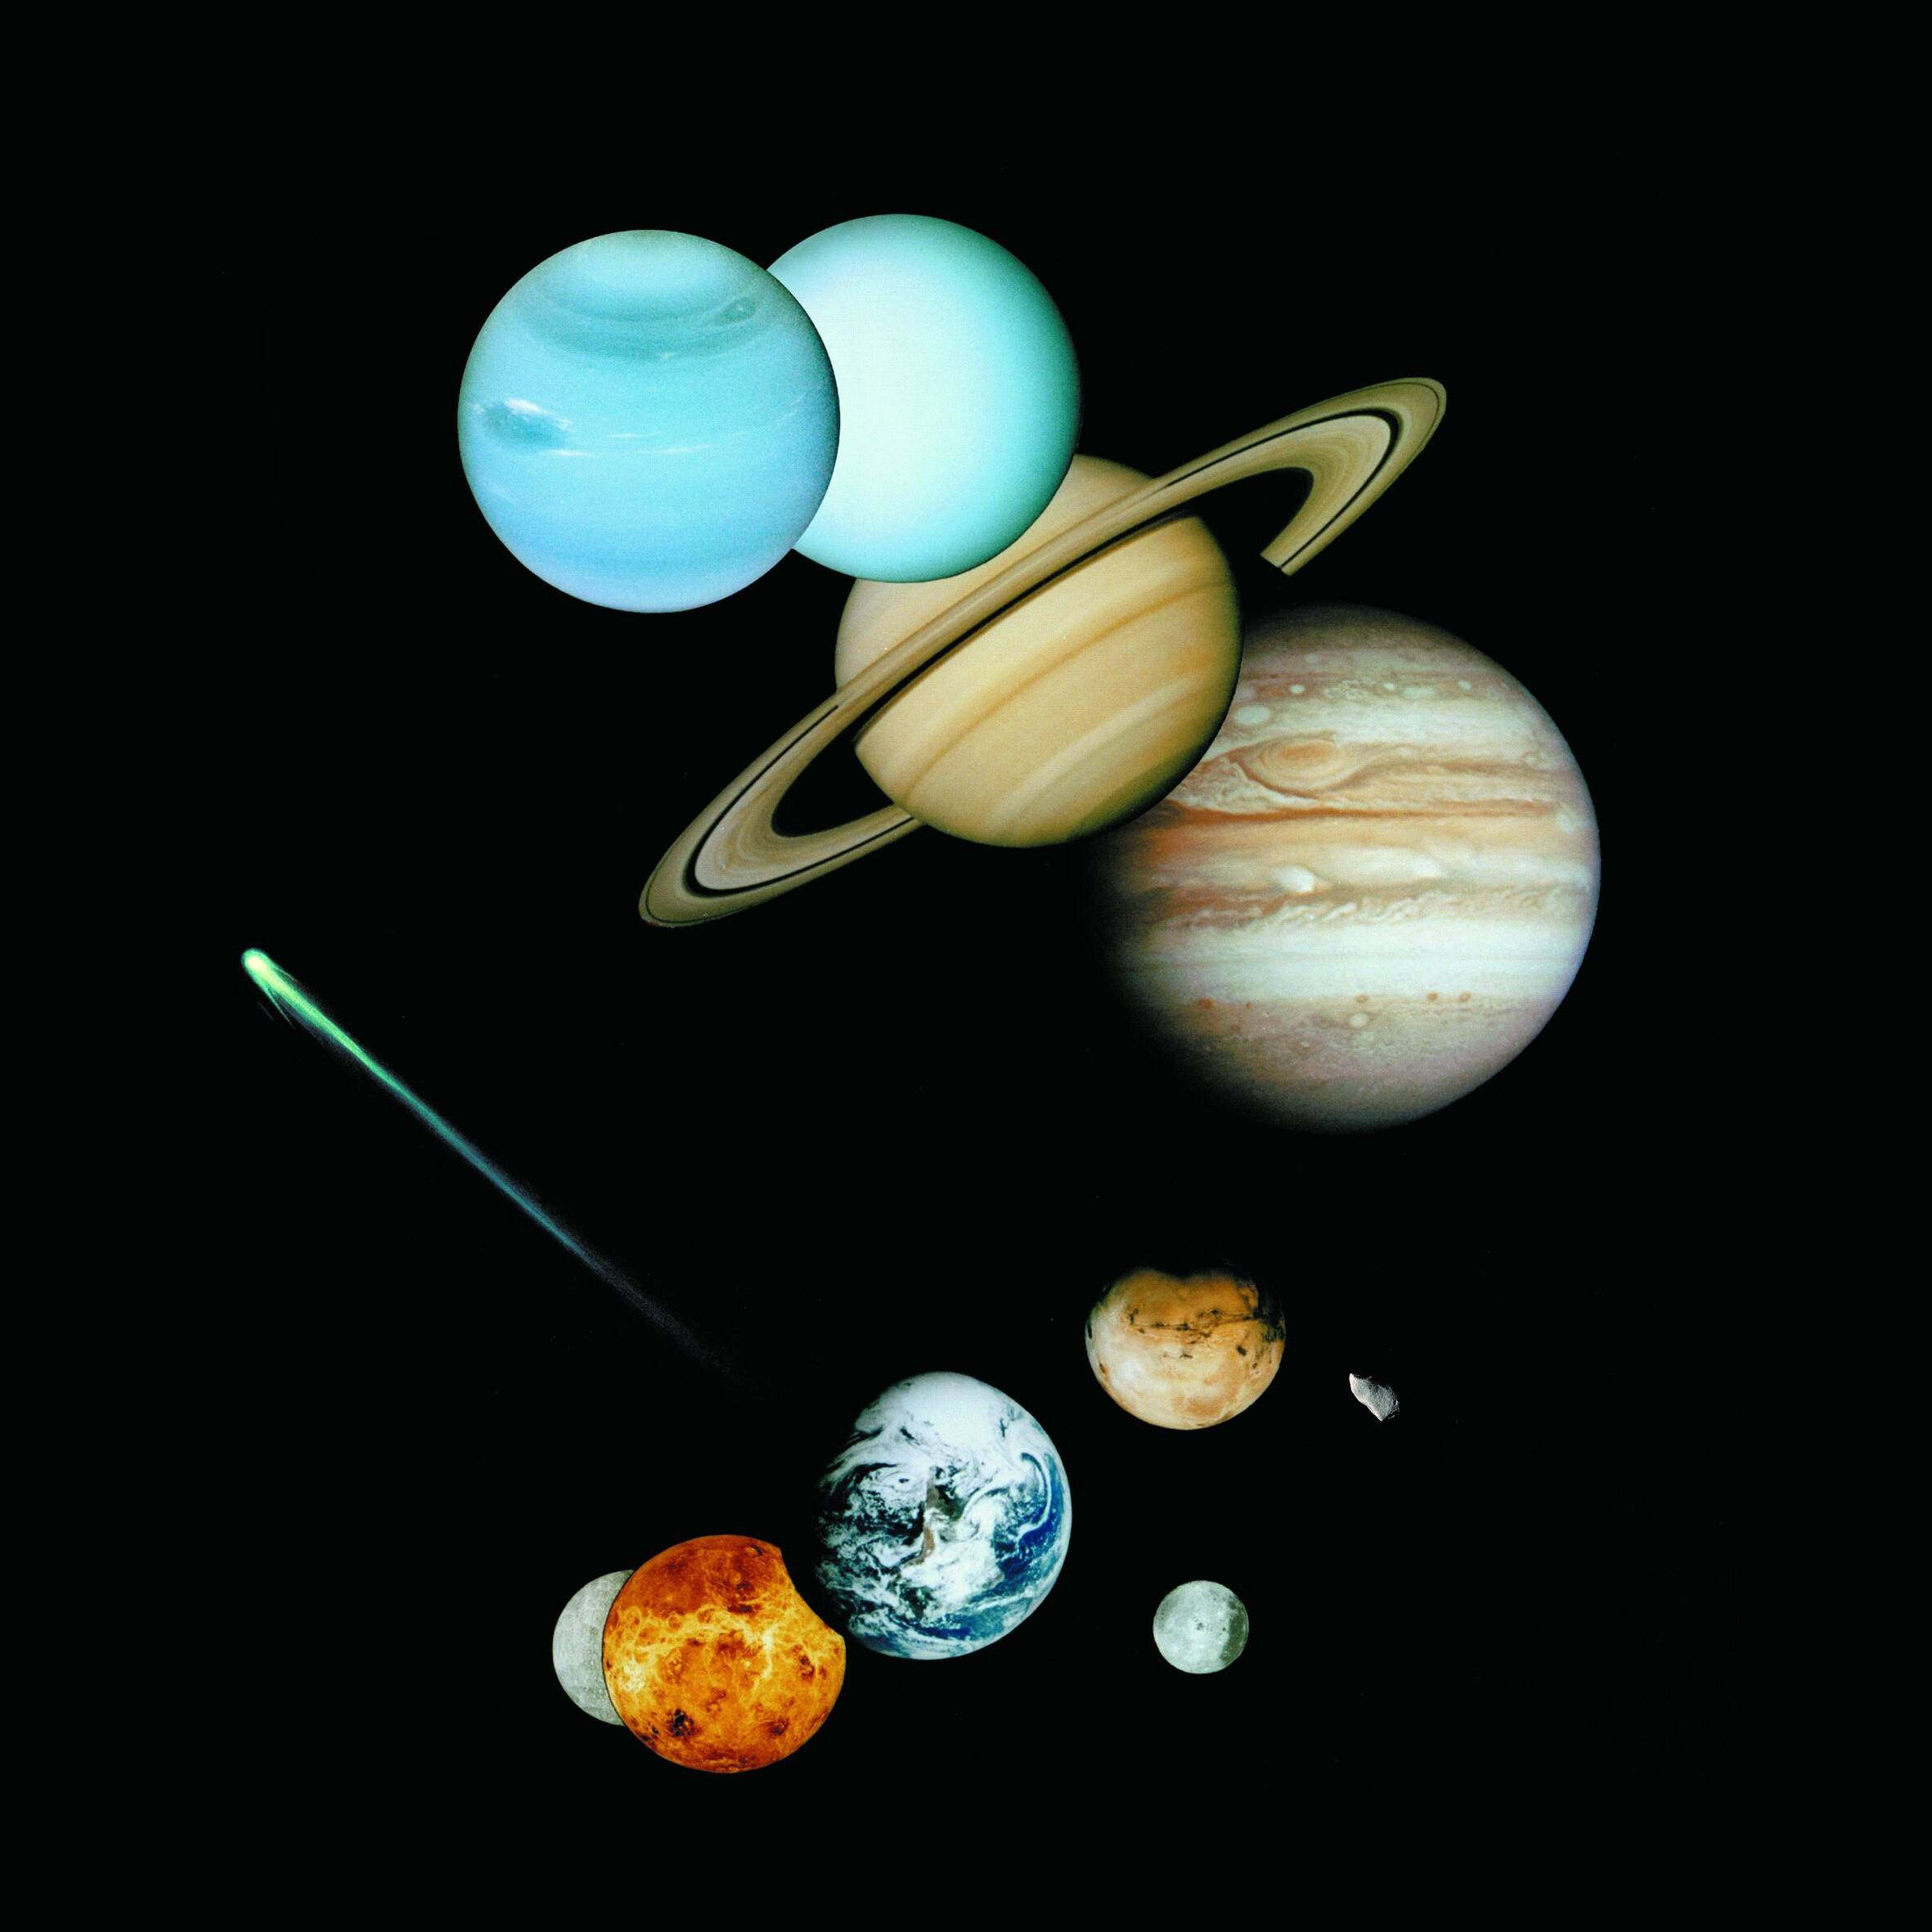
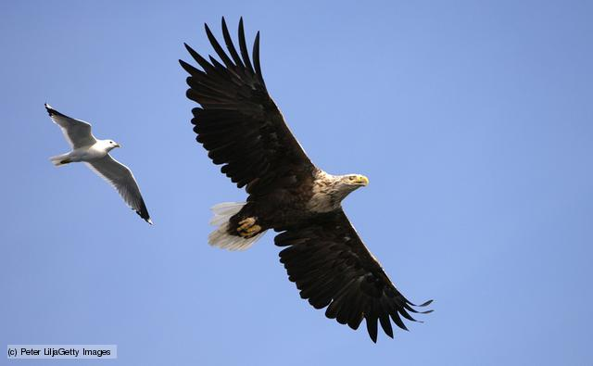
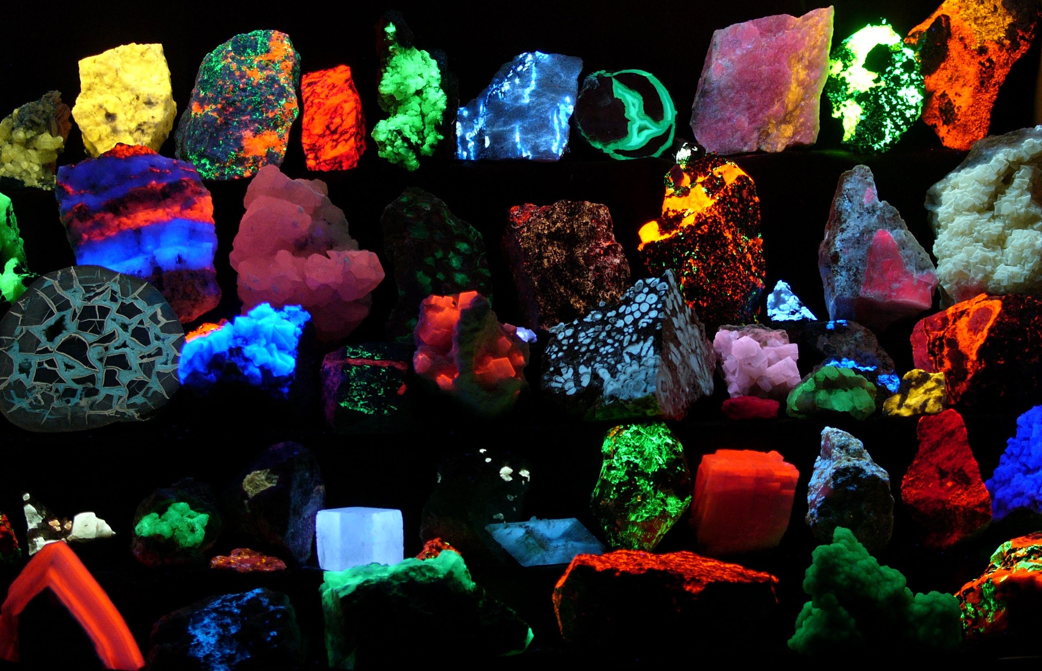
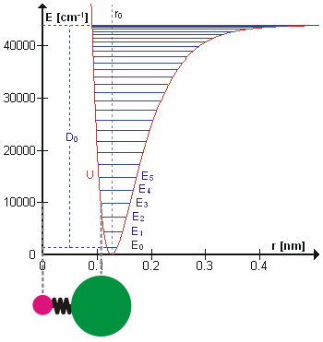

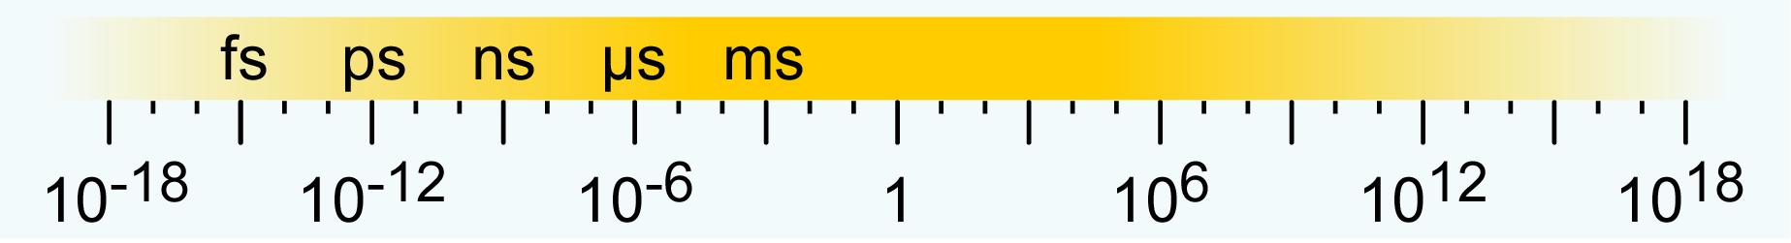
What for attosecond
Time scales of phenomena
planet orbiting & rotation
visible object motion
coupling to the vacuum & molecular rotation
molecular vibration & chemical reaction
age of the
mankind
age of the
universe
electronic motion & e-e correlations
as
VUV/x-ray techniques
time / seconds
stop watch
optical technologies
camera diaphragm
fast electronics

Slide 5
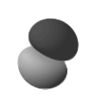
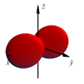
What moves?
Superposition of energetically non-degenerate wavefunctions
Stationary states (e.g. atomic eigenstates)
Superpositions of non degenerate states
FO.R.T.H. - I.E.S.L.

Slide 6
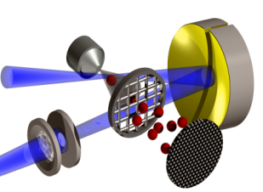
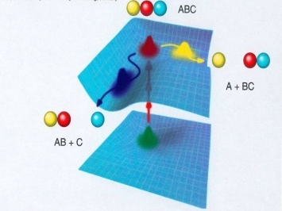
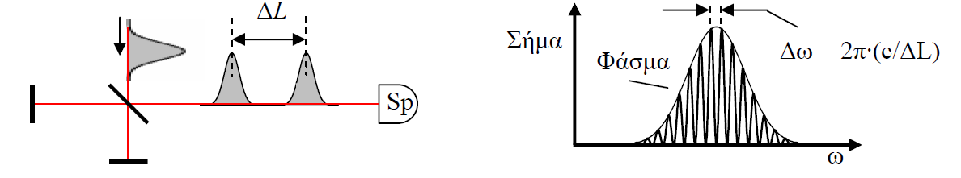
Why intense XUV/attosecond pulses
Non-linear XUV processes
Ultra-short pulse metrology
Pump-probe studies of ultra-fast dynamics
(asec temporal resolution)
Spatially resolved dynamics
(nm - Å spatial selectivity, 4D diagnostics)
High frequency resolution (sequence of coherent pulses)

Slide 7
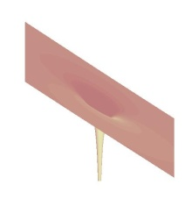
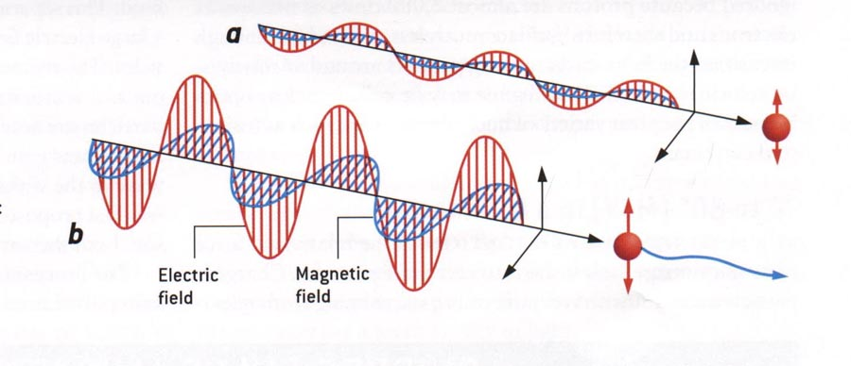
Interactions underlying laser based XUV genereation
Strong field interactions
Gas, liquid, solid state, plasma
v<<c
a₀<<1, a₀>>a₀²
v ~ c
v ~ c
a₀>>1, a₀<<a₀²
FO.R.T.H. - I.E.S.L.

Slide 8
Outline
  Laser: 40fs, 170mJ,
  @ source: XUV asec trains:1µJ-40µJ, XUV continua: sub- 100nJ
  @ target: ~10¹⁴ W/cm²
  Introduction
      Generation
          Characterization
              Applications
FO.R.T.H. - I.E.S.L.

Slide 9


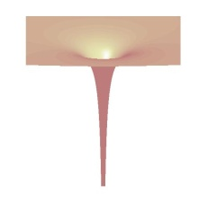
High Harmonic Generation (HHG) from gas targets
The “single atom response”
Gy. Farkas & Cs Tóth
Phys. Lett. A 168,447 (1992)
L'Huillier (1988)
1.3 fs
I_{p}
+
-
+
-
+
-
e⁻
K. Kulander PRL 68 3535 (1992)
P. B. Corkum PRL 71, 1995 (1993)
M. Lewenstein PRA 49 2117(1994)
FO.R.T.H. - I.E.S.L.

Slide 10
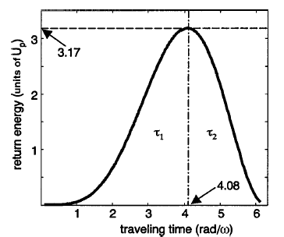
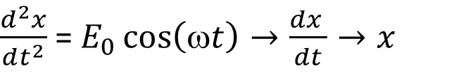
HHG in gases
The three step models (TSM)
Classical
Approximations
Strong Field Approximation (SFA)
Single Active Electron (SAE)
υ(0) = 0
$\frac{d^{2}x}{dt^{2}}$ = $E_{0}\cos\left(ωt\right)→\frac{dx }{dt}→x$
F. Lindner et al.
PRA 68, 013814 (2003)
I_{XUV}
ω
FO.R.T.H. - I.E.S.L.

Slide 11
HHG in gases
The TSMs
Semi-Classical
Approximations
Strong Field Approximation (SFA)
Single Active Electron (SAE)
Electric Dipole Approximation (EDA)
Quasi Static Approximation (QSA)
No Resonance Approximation (NRA)
Weak Ionization Approximation (WIA)
FO.R.T.H. - I.E.S.L.

Slide 12
HHG in gases
The TSMs
Quasi-classical action
Saddle point equations
Semi-classical
M. Lewenstein
PRA 49 2117(1994)
Quantum trajectories
numerical
SPA
FO.R.T.H. - I.E.S.L.

Slide 13
Mapping HHG intricacies in the spatial ion distributions
Imaging of the HHG focal area in the ionization focal area
FO.R.T.H. - I.E.S.L.

Slide 14
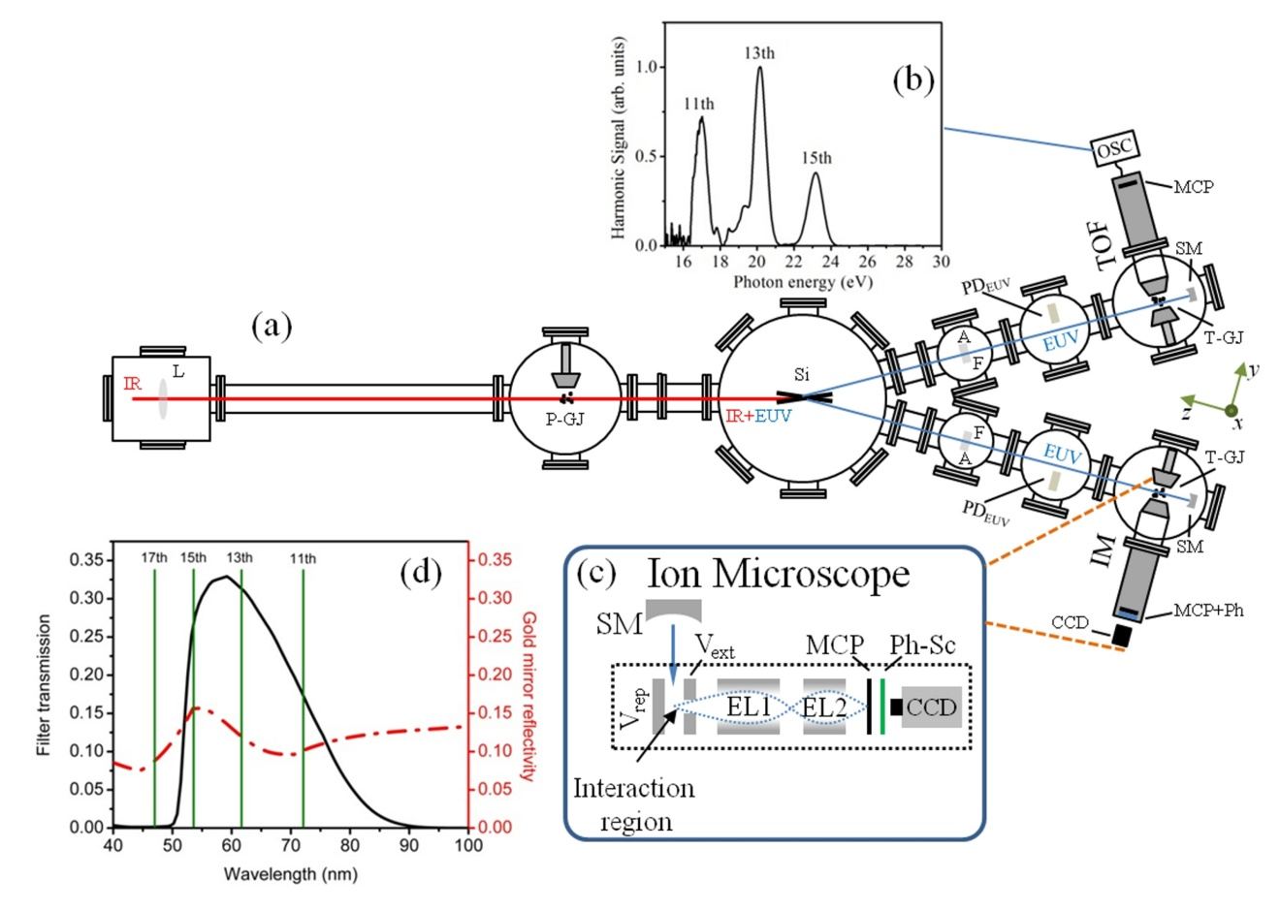
Mapping HHG intricacies in the spatial ion distributions
Long-short trajectory interferences
Different trajectories result different harmonic phases
→ consuctive/distructve
interference
Phases depend on the driving intensity
Long-short trajectory phase difference depends on the driving intensity → interference depends on the driving intensity
Intensity varies:
i) spatially → interference
pattern varies spatially
ii) by external control →
interference pattern
depends on the used intensity
FO.R.T.H. - I.E.S.L.

Slide 15
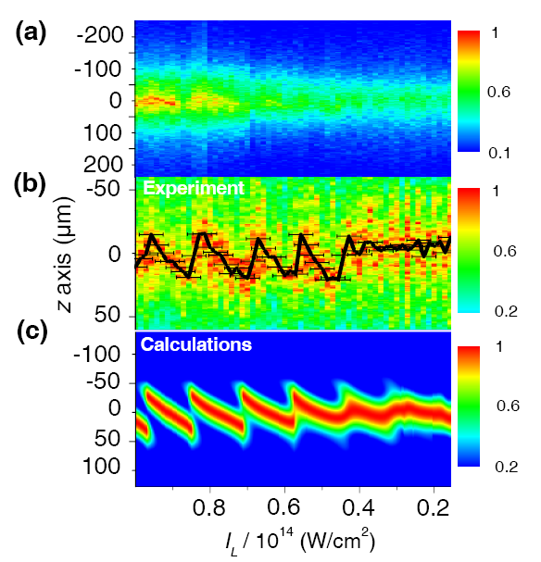
Mapping HHG intricacies in the spatial ion distributions
Long-short trajectory interferences
Line outs of the focus images
Plateau
Two trajectories
Cut-off
Periodic structure
Single trajectory
Norm. data
No structure
G. Kolliopoulos et al., PRA 90, 013822 (2014)
FO.R.T.H. - I.E.S.L.

Slide 16
Mapping HHG intricacies in the spatial ion distributions
Revealing quantum path details
Δt_{e}=nλ/2c
9π
8π
7π
6π
5π
4π
3π
2π
π
0
ΔL_{e}=(2(E_{e}+IP)/m_{e})^{1/2}Δt_{e}
E_{e}=1.5 Up (0<E_{e}<3.17 Up)
FO.R.T.H. - I.E.S.L.

Slide 17
Optimization of HHG
Phase matching
L_{med}
Phase matching:
focused beams ⇒
Δk_{g}
=
qk_{1,g}- k_{q,g}
Focused beams / strong field:
dispersive medium n_{ω}≠n_{qω} ⇒
Δk_{atom}
, Δk_{el}
k_{q} = qk₁
+ Δk_{g}
+ Δk_{atom}
− α_{q}∇I_{L}
strong field regime ⇒ ∇ϕ_{q} = -α_{q}∇I_{L}(r,z)
            α_{q}∝ t_{e}
FO.R.T.H. - I.E.S.L.

Slide 18
Optimization of HHG
Phase matching in focused beams in a gas jet
Jet before focus
Jet after focus
k_{q}
−α_{q}∇I_{L}
r
− α_{q}∇I_{L}
qk₁
k_{q}
Δk_{atom}
k_{q}
Δk_{atom}
Δk_{atom}
−α_{q}∇I_{L}
z
Δk_{g}
qk₁
Δk_{g}
qk₁
Δk_{g}
Off-axis phase matching
On-axis phase matching
Off-axis
On-axis
x,y
T_{L}/2
no attos
t
T_{L}/2
no attos
t
T_{L}/2
t
x,y
large a_{q} necessary =>
long trajectory is favored
small a_{q} necessary =>
short trajectory is favored
FO.R.T.H. - I.E.S.L.

Slide 19
Limitations on the XUV intensity of gas harmonics
Saturation of ionization and absorption
Depletion of the medium + phase mismatch by electrons
Absorption
L_{med}N_{AT} = const
P_{XUV} ∝ S²
FO.R.T.H. - I.E.S.L.

Slide 20
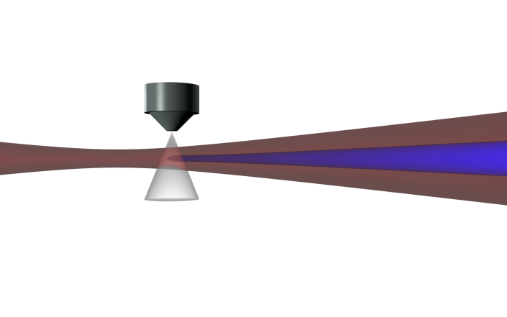
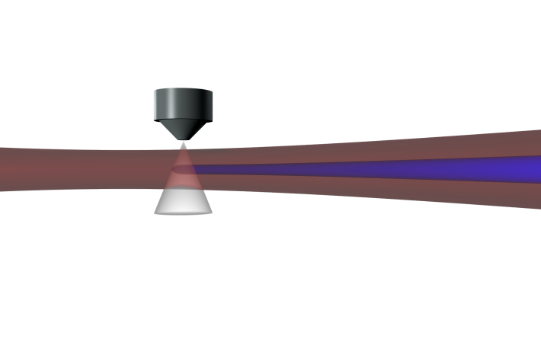
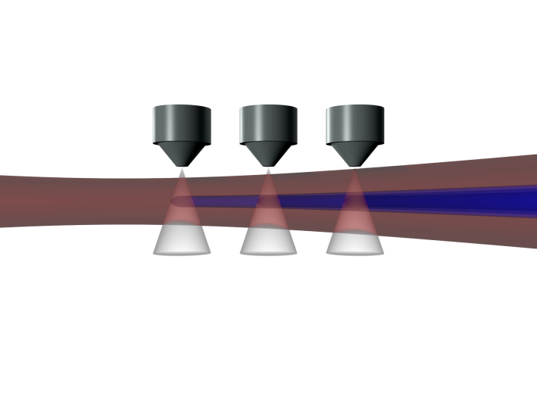
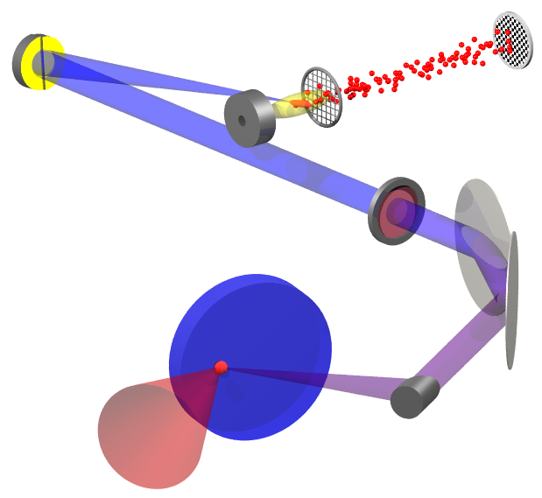
Generation of intense asec pulse trains & pulses
Recipes
For depleting/absorbing targets (e.g. atoms) avoid depletion through:
i) Loose focusing ( yield ∝ f² )
ii) Short pulse duration
iii) Quasi phase matching
2. For non depleting targets (e.g. surface plasma) use highest possible intensity (tight focusing)
FO.R.T.H. - I.E.S.L.

Slide 21
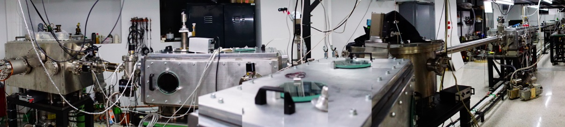
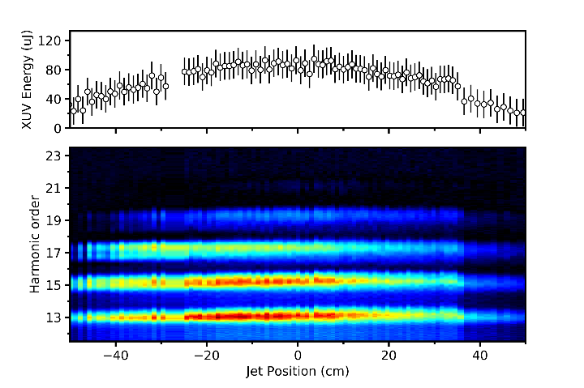
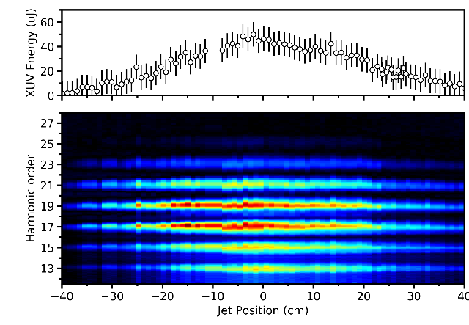
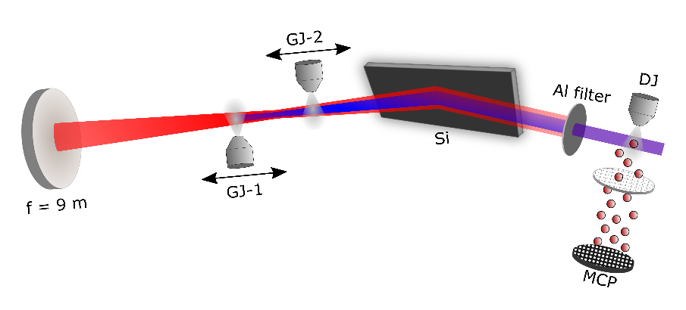
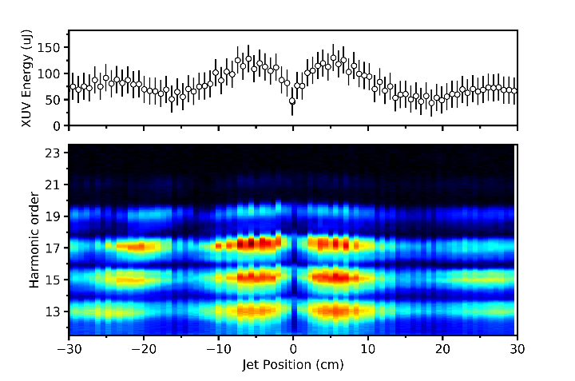
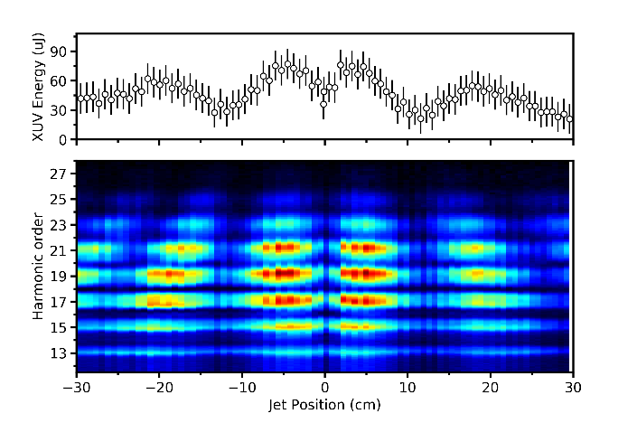
Generation of intense asec pulse trains & pulses
The new attosecond beam-line @ FORTH
20m
HHG chamber
Experimental chamber
(Split spherical mirror XUV-pump-XUV-probe facility)
XUV beam manipulation
Chamber (irises, filters, toroidal mirror systems)
XUV-IR separation & beam wavefront/ XUV delay line
splitter chamber
Focusing optics chamber
2nd Experimental chamber
85 μJ
50 μJ
Xe, 15-30 eV
Ar, 15-38 eV
Driving laser: 10Hz, few tens of mJ (out of 400mJ), 20 fs @800nm)
120 μJ
80 μJ
FO.R.T.H. - I.E.S.L.

Slide 22
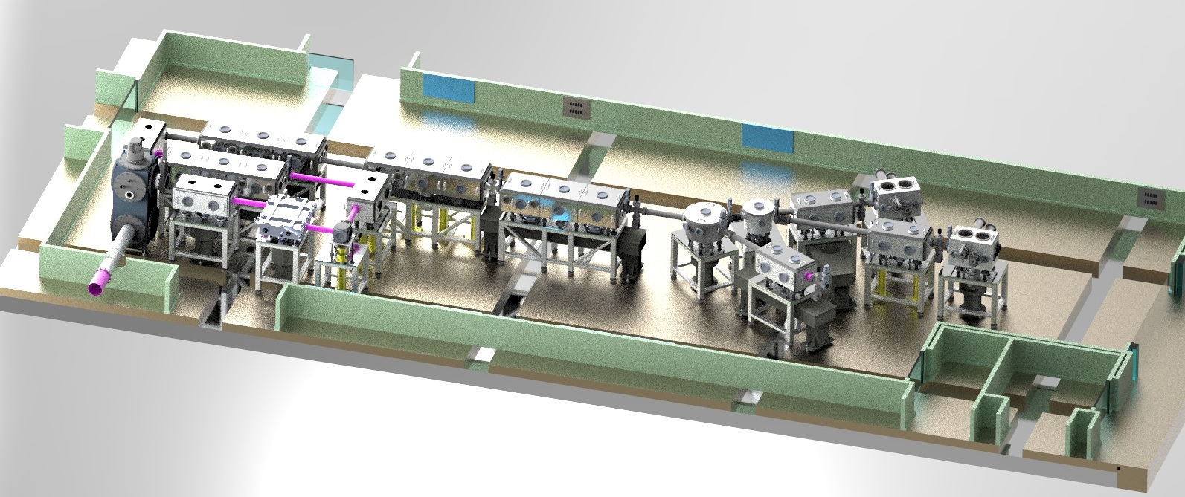
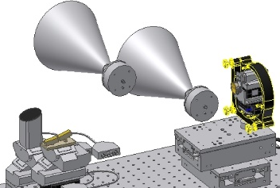
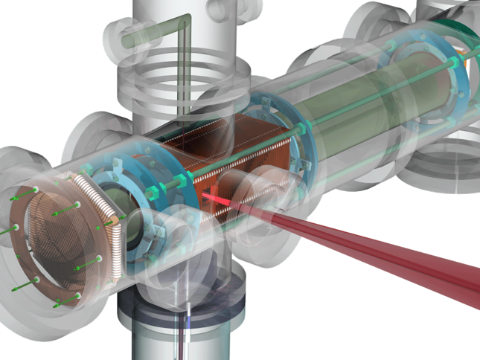
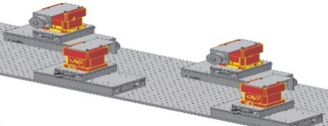

The ALPS secondary sources
The SYLOS “compact” GHHG source
Focusing set ups
RABITT & 2nd IVAC
TOF1
split
mirror
f = 3, 6, 9 m
TOF2
Generation
Si mirror
NL XUV
Separation
toroidals
Polarization
gating
IR-XUV
QPM arrangement
User end-station arm
ReMi
20m
Driving laser (SYLOS, @~900nm):
By 2019-20: 1 kHz, >100 mJ, < 5 fs, CEP

Slide 23
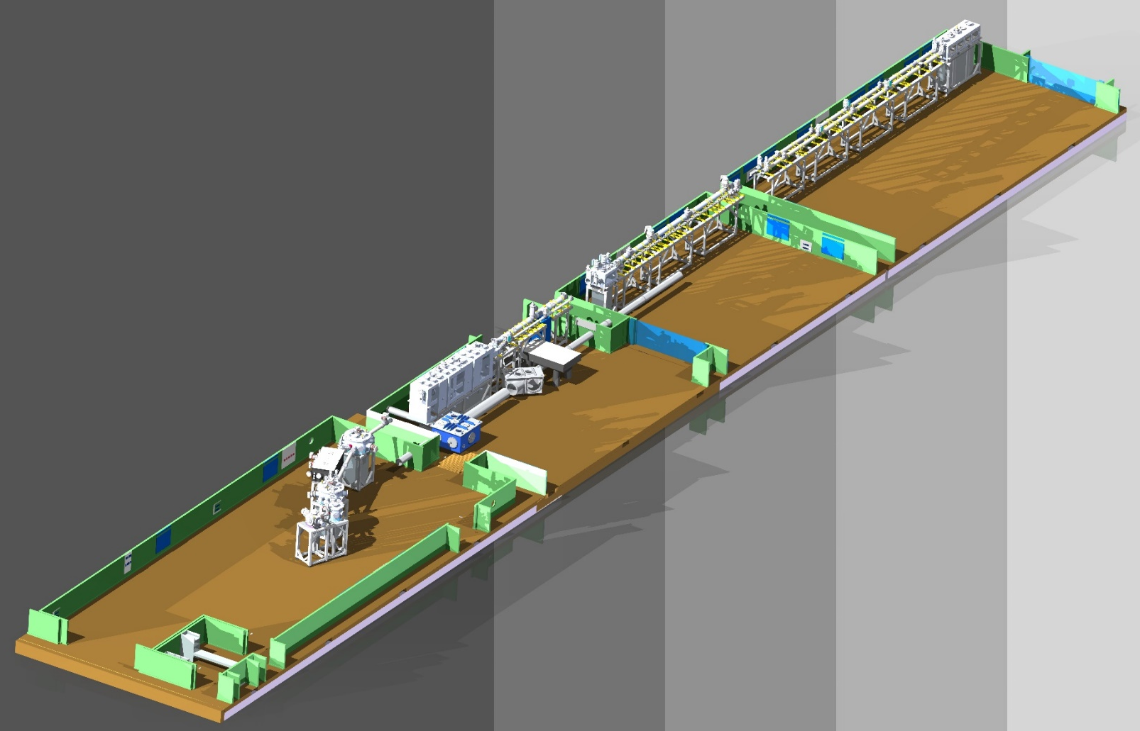
The ALPS secondary sources
The SYLOS “long” GHHG source
50 m
Pump-probe options
XUV + XUV
XUV + IR
XUV + XUV + IR
XUV + XUV + IR + IR / SHG / THG / VUV / XUV
ReMi

Slide 24
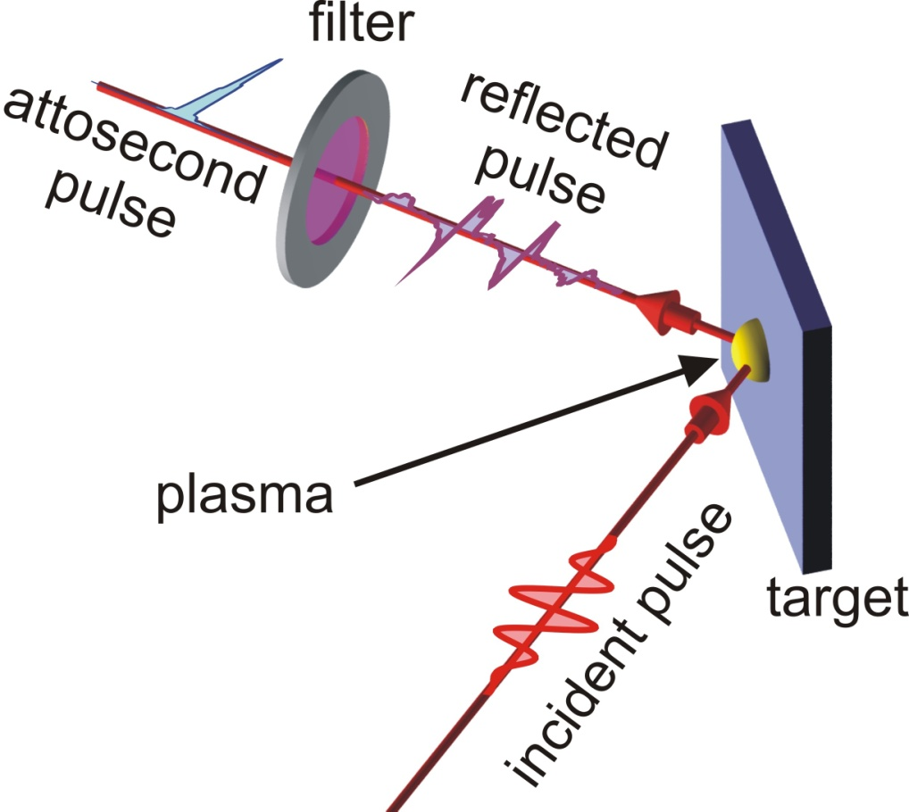
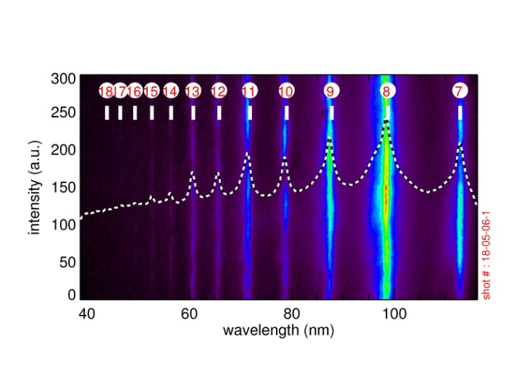
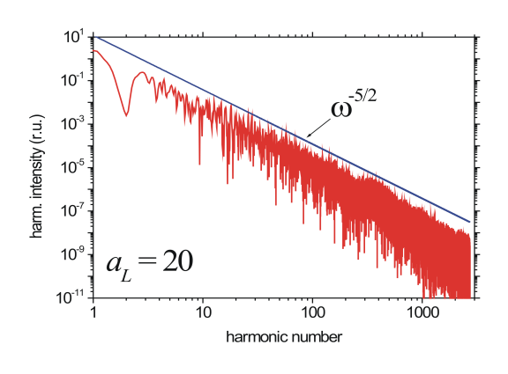
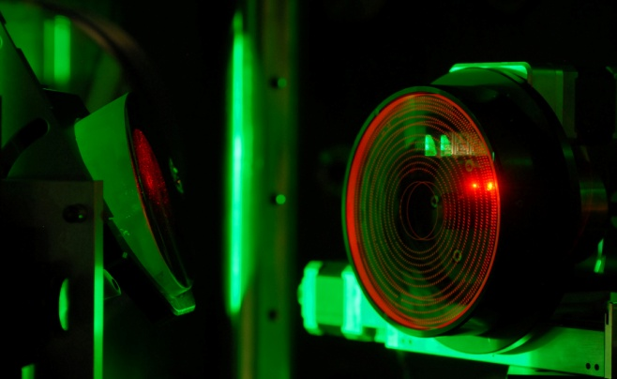
The plasma medium Surface plasma harmonics
B. Dromey et al., Nat. Phys., 2, 456 (2006)
B. Dromey et al., PRL, 99, 085001 (2007).
A. Tarasevitch et al., PRL, 98, 103902 (2007)
Y. Nomura et al., Nat. Phys. 5, 124 (2009)
Introduction of a band-pass filter results in attosecond pulses

Slide 25

Surface plasma harmonic emission The relativistic oscillating mirror (ROM) regime
T. Baeva, PRE 74, 046404 (2006)
ROM (a_{L}>1⇒ I_{L}< 10¹⁸ W/cm² @ 800nm)
Incident
overdense
Reflected
z
t
velocity
FO.R.T.H. - I.E.S.L.

Slide 26
Energetic coherent XUV continua Interferometric Polarization Gating (IPG) & loose focusing
2
3
1
4
e⁻
See also: Y. Silberberg, D.M. Villeneuve et al.
PRA 72, 063816 (2006)
P. B. Corkum et al. Opt. Lett. 19, 1870 (1994)
Gate on
Gate off
L
D
Ar-jet
Toroidal grating
P. Tzallas et al. Nature Phys. 3, 846 (2007)
FO.R.T.H. - I.E.S.L.

Slide 27
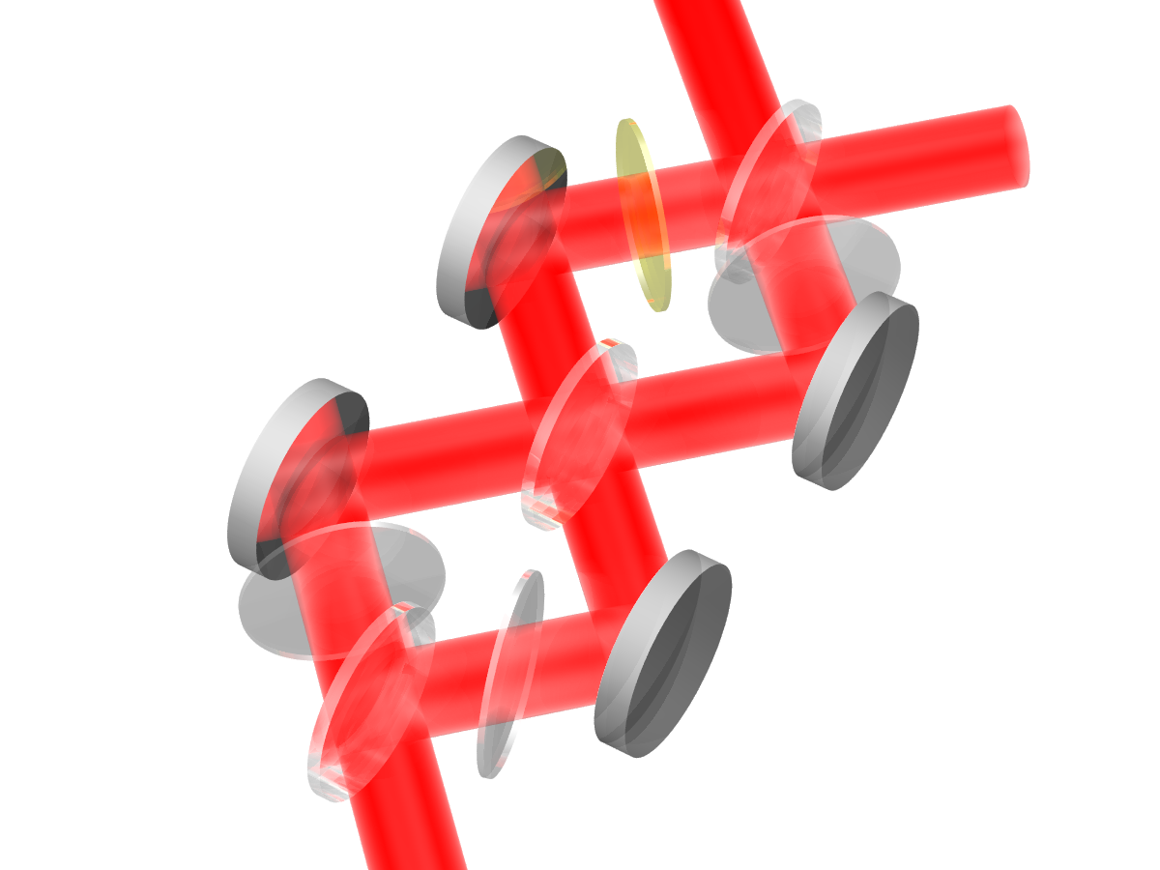
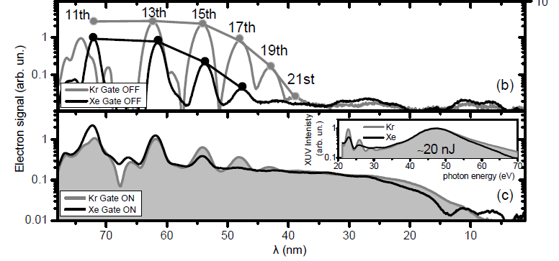
Coherent XUV continua in the sub-100 nJ range Interferometric Polarization Gating (IPG) & loose focusing
4
2,3
1
This result is scalebar
f = 3m → f = 15m &
100mJ, 50fs → 1J, 20fs (IR)
⇒20nJ → 1 mJ (XUV)
E. Skantzakis et al. Opt. Lett. 34, 1732 (2009)
FO.R.T.H. - I.E.S.L.

Slide 28


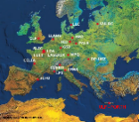




GHHG from aligned molecules
XUV polarization control
$$ = 0.97
$$ = 1.23
$$ = 1.19
E. Skatzakis et al. Sci Rep. 2016; 6: 39295. doi: 10.1038/srep39295
FO.R.T.H. - I.E.S.L.

Slide 29
Outline
  Introduction
      Generation
          Characterization
              Applications
FO.R.T.H. - I.E.S.L.

Slide 30
fs pulse metrology 2nd order autocorrelation
[1st order AC]²
2nd order AC
NL Crystal
Gives an estimation of the pulse duration
Interferogram is the FT of the spectrum. Gives the pulse coherence time i.e. the inverse of the bandwidth
FO.R.T.H. - I.E.S.L.

Slide 31
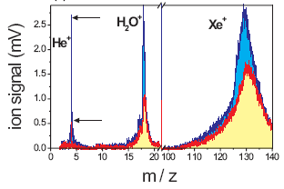
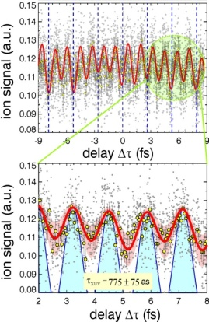
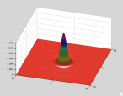

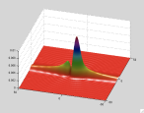
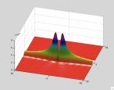

Attosecond pulse metrology 2nd order IVAC
IR: f=3m, 50 fs, 15mJ XUV: 0.5μJ@source, 10¹⁴ W/cm²@target
Two-XUV-photon He ionization
N. A. Papadogiannis et al. Phys. Rev. Lett. 90, 133902 (2003) N. A. Papadogiannis et al. Appl. Phys. B76, 721 (2003)
E. Benis et al. New J. of Phys. 8, 92 (2006)
2nd order IVAC
P. Tzallas et al. Nature 426, 267 (2003) P. Tzallas et al. J. Mod. Opt. 52, 321 (2005)
L. A. A. Nikolopoulos et. al. Phys. Rev. Lett. 94, 113905 (2005)
P. Tzallas et al. Appl. Phys. B (2009)
φ=0
φ=π/2
φ=π
FO.R.T.H. - I.E.S.L.

Slide 32
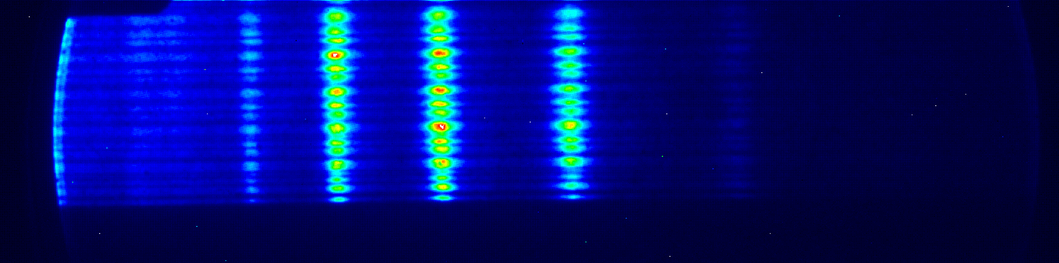
Surface plasma harmonics Temporal characterization: Exp. set up
MCP
Ion spectrum
Split mirror
6
TOF
He⁺
Gas jet
5
H₂O⁺
4
O₂⁺
Ion signal (arb. units)
3
N₂⁺
Si wafers
2
Ar⁺
1
0
5
10
15
20
25
30
35
40
45
50
Target
In filter
m
/
Z
ATLAS
~800 nm
~45 fs
~1 J
Plexiglas: No harmonic above 15th
Parabola
Conversion efficiency: 6⋅10⁻⁵
Energy @ source:~40µJ
Y. Nomura et al., Nature Phys. 5, 124 (2009)
FO.R.T.H. - I.E.S.L.

Slide 33
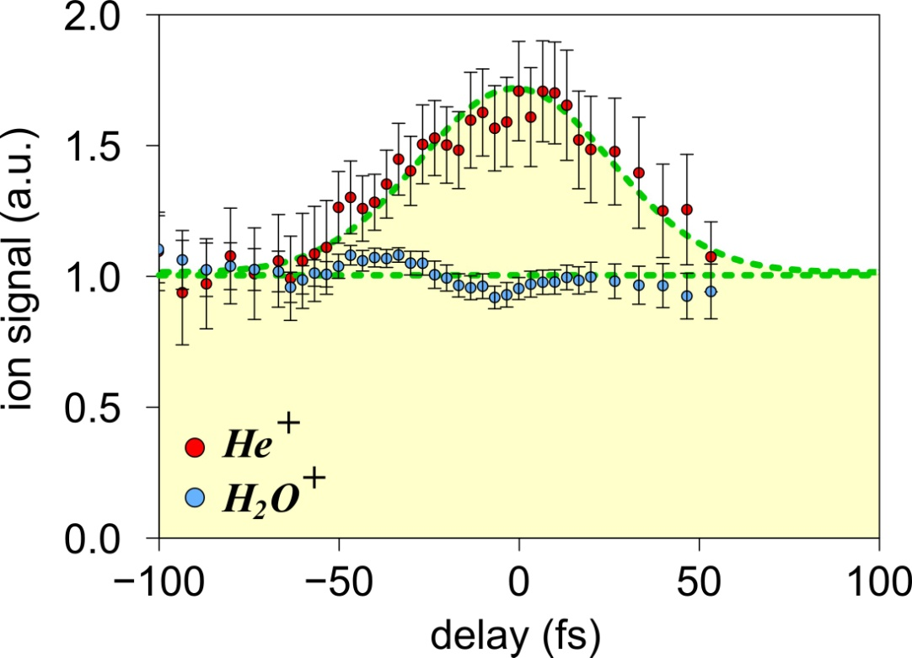
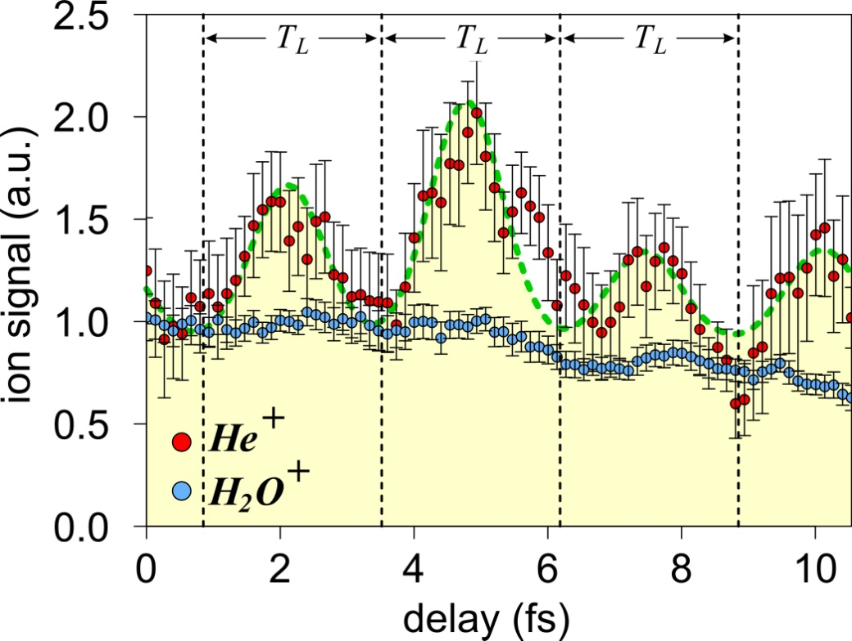
Surface plasma harmonics Second order autocorrelation measurements
Coarse scan
Fine scan
XUV emission duration ~45 fs
XUV pulse train with ~0.9 fs duration
Y. Nomura et al., Nature Phys. 5, 124 (2009)
FO.R.T.H. - I.E.S.L.

Slide 34
Outline
  Introduction
      Generation
          Characterization
              Applications
FO.R.T.H. - I.E.S.L.

Slide 35
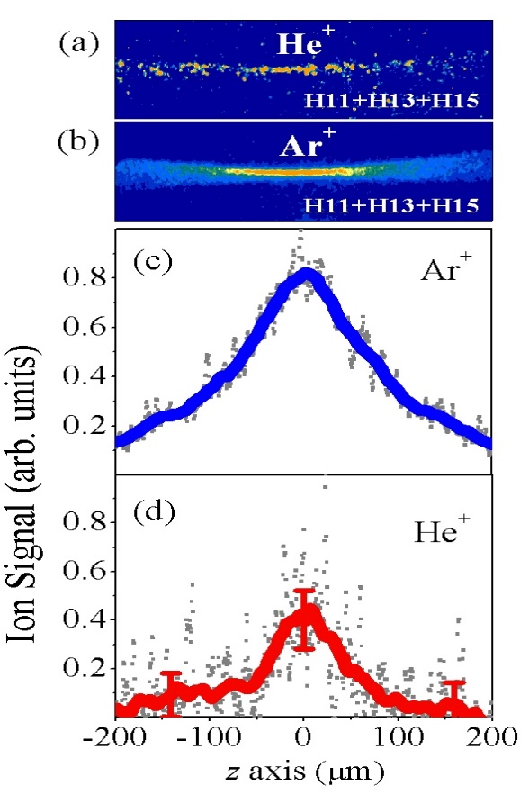
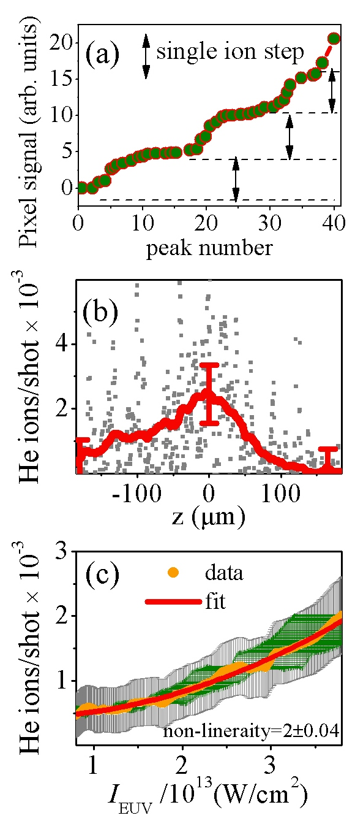
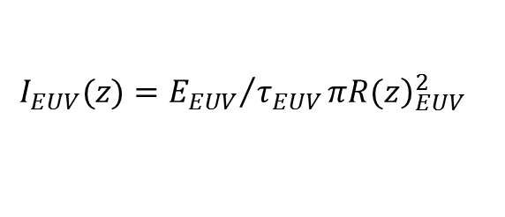
Spatially resolved two XUV photon ionization of He
Towards single shot NL autocorrelation in the XUV
He⁺
11ω
13ω
15ω
He
$$I_{EUV}(z)={E_{EUV}}/{τ_{EUV}}π{\left.R(z\right)}_{EUV}^{2}$$
N. Tsatrafyllis et al. Sci Rep. (2016)
FO.R.T.H. - I.E.S.L.

Slide 36


Spatially resolved two XUV photon ionization of He
Quantitative measurements in the XUV
$$σ^{(2)}={\left(ℏω_{EUV}\right)}^{2}N_{ions}^{He}/(I_{EUV}^{2}τ_{EUV}ρ_{He}V(z))$$
$$\left.ρ_{Ar}=\left(ℏω_{EUV}\right){N_{ions}^{Ar}}/(I_{EUV}τ_{EUV}σ^{\left(1\right)}V(z)\right)$$
σ⁽¹⁾ ≈ 33 Mb
27. G. Kolliopoulos , et al.,Phys. Rev. A 90, 013822 (2014).
34. C. G. Wahlstrom, et al., Phys. Rev. A 48, 4709 (1993).
35. A. Saenz and P. Lambropoulos, J. Phys. B 32, 5629 (1999).
36. H. W. van der Hart and P. Bingham, J. Phys. B 38, 207 (2005).
N. Tsatrafyllis et al. Sci Rep. (2016)
FO.R.T.H. - I.E.S.L.

Slide 37
Applications of energetic XUV super-continua XUV-pump-XUV-probe of ultrafast evolving atomic coherences
FO.R.T.H. - I.E.S.L.

Slide 38
Applications of energetic XUV super-continua XUV-pump-XUV-probe of ultrafast evolving atomic coherences
[1st order AC]²
2nd order AC
AIS manifold:
10 doubly excited states
&
[²S_{1/2} ]6p - [²S_{1/2} ]12p inner shell (5s) excited states
FO.R.T.H. - I.E.S.L.

Slide 39

Applications of energetic XUV super-continua 2nd order IVAC and the XUV-pump-XUV-probe trace
On the AC trace
Sequential double ionization:
Square of the 1st order AC, FTL width (420asec)
Direct double ionization:
2nd order AC
FO.R.T.H. - I.E.S.L.

Slide 40
Few cycle pulses
Shot to shot CEP variation
Δφ
Electric field
t
τ =1/f_{rep}= 2π/ω
0
FO.R.T.H. - I.E.S.L.

Slide 41
Two-XUV-photon SDI vs DDI SDI AC traces (square of the 1st order AC trace)
FTL duration: 420 asec
420 asec
FO.R.T.H. - I.E.S.L.

Slide 42
Applications of energetic XUV super-continua 2nd order IVAC and the XUV-pump-XUV-probe trace
On the AC trace
Direct double ionization⇒ 2nd order AC
P. Tzallas et all. Nature Physics
published on line 3 July 2011
DOI: 10.1038/NPHYS2033
FO.R.T.H. - I.E.S.L.

Slide 43
Effect of the non-stable CEP Averaged 2nd order AC traces of single/double-peak pulses
FO.R.T.H. - I.E.S.L.

Slide 44
Applications of energetic XUV super-continua 2nd order IVAC and the XUV-pump-XUV-probe trace
On the trace @ long delays
Dynamics of the induced atomic coherence,
Ultra-broad-band FT spectroscopy
P. Tzallas et all. Nature Physics
published on line 3 July 2011
DOI: 10.1038/NPHYS2033
FO.R.T.H. - I.E.S.L.

Slide 45



Applications of energetic XUV super-continua XUV-pump-XUV-probe studies of 1fs scale intrinsic molecular dynamics
Carpeggiani et al. Phys. Rev. A89, 023420 (2014)
FO.R.T.H. - I.E.S.L.

Slide 46


Applications of energetic XUV super-continua XUV-pump-XUV-probe studies of 1fs scale intrinsic molecular dynamics
FO.R.T.H. - I.E.S.L.

Slide 47
















Schematics of ELI-ALPS
Lasers, Secondary Sources, End-stations
Primary sources
(laser beams)
Secondary sources
(attosecond pulses, particles, THz, MIR)
Experiments
PW SHHG
PW Ion/electron
acceleration
SYLOS SHHG
SYLOS e⁻
acceleration
SYLOS (1kHz, 100mJ, 5fs, CEP)
HF (2PW, 10Hz, 17fs)
SYLOS “long” GHHG
MIR
SYLOS “compact” GHHG
HR (100kHz, 5mJ, 6 fs, CEP)
HR GHHG GP
HR GHHG S/CM

Slide 48




Future perspectives The ELI-ALPS challenge & opportunity
http://www.eli-alps.hu/?q=en
Coupled electon-nuclear dynamics in small molecules require REMI @ high XUV intenisties & high rep rates
Dymanics in sequential vs non-sequential double ionization of helium require REMI @ high XUV intenisties & high rep rates
Requires
High XUV intensities (10¹⁵- 10¹⁶ W/cm²)
High rep rate (>1kHz)
High temporal resolution (~100 asec)
Uniquely available @ ELI-ALPS
A. Palacios et al. PNAS111, 3973 (2014)
Feist et al. PRL103, 06302 (2009)

Slide 49














Thank you for your attention !
Collaborations
G. D. Tsakiris
H. Schröder
L. Veisz
B. Bergues
L. A.A.
Nikolopoulos
F. Martin
Palacios
D. Robotis
M. Dresher
O. Faucher
E. Hertz
A. Zair
J. Marangos
P. Dombi
G. Sansone
0
FORTH team members
in the last 5 years
P. Tzallas (researcher)
C. Kalpouzos (researcher)
E. Kosma (Post doc)
E. Skatzakis (Post doc)
I. Gonoskov (Post doc)
G. Kolliopoulos (PhD)
B. Bodi (PhD)
S. Chatziathanasiou (PhD)
P. A. Carpeggiani (PhD)
G. Antonaropoulos (PhD)
J. Kruse (PhD)
I. Tsatrafilis (PhD)
D. Gray (laser technician)
N. Papadakis (technician)
A. Kargazis (technician)
& D. Charalambidis
Supported by: ATTOFEL-ITN, CRISP, Laserlab Europe, MEDIA-ITN, NSRF

Slide 50


On the challenge of attosecond metrology 2nd order IVAC vs RABITT
2nd Order IVAC
RABITT
τ
S_{q,q-2} (τ )~ cos(2ω_{IR}τ + ϕ_{q} - ϕ_{q-2})
FO.R.T.H. - I.E.S.L.

Slide 51




On the challenge of attosecond metrology 2nd order IVAC vs RABITT
Measures <ϕ_{q}>
Measures <τ>
9-15 harmonics | Focus before jet | Focus at jet | Focus after jet
RABITT | 350 as | 600 as | 1020 as
2-IVAC | 660 as | - | -
J. Kruse et al. PRA A 82, 061401(R) (2010)
FO.R.T.H. - I.E.S.L.

Slide 52
On the challenge of attosecond metrology RABITT reveals short & long trajectory contributions
focus position | S12 (%) | S14 (%) | S16 (%)
z_{BJ} | ~ 23 | ~ 33 | ~ 55
z_{OJ} | ~ 23 | ~ 40 | ~ 65
z_{AJ} | ~ 23 | ~ 45 | ~ 95
J. Kruse et al. PRA Rap. Com. (accepted)
FO.R.T.H. - I.E.S.L.

Slide 53
Time resolved XUV spectroscopy Ultra fast dynamics in RETPI of C₂H₄
C₂H₄⁺
C₂H₂⁺, C₂H₃⁺
τ₁
V
(ππ* B_{1U})
5th harmonic
τ₂
H₃C-CH
N (A_{g})
Multi-dimensional dynamics
ϕ
0 90 180
FO.R.T.H. - I.E.S.L.

Slide 54
Time resolved XUV spectroscopy Ultra fast dynamics in RETPI of C₂H₄
Kr
5th harmonic
Δt
NRTPI
RETPI
τ₁=23fs
τ_{p}=31fs
fs
fs
C₂H₄
RETPI
RETPI
ππ* (B_{1U})
τ₂=10fs
τ₂=10fs
Δt
fs
fs
5th harmonic
A. Peralta Conde et al., PRA 79 061405(R) (2009)
FO.R.T.H. - I.E.S.L.

Slide 55


HHG in gases
The models
Quantum
$$i\frac{∂Ψ}{∂t}=\frac{1}{2}\left[p−\hat{A}\right]$$
Free e⁻ in quantized field
Semi-classical Volkov wave function
$$_{sc}^{\left(V\right)}\left(t\right)\text{∝}\text{e}\text{xp}\text{}\text{−}\frac{i}{η}\int_{t_{0}}^{t}{\left[\frac{p^{2}}{2m}+\frac{pA\left(τ\right)}{2m}+\frac{A^{2}(τ)}{2m}\right]}\text{d}τ$$
Quantum optical Volkov wave function
$_{qo}^{\left(V\right)}\left(p,q,t\right)\text{∝}\text{e}\text{xp}\text{}\text{b}\text{(}\text{t}\text{)}\text{·}p^{2}+p[d(t)\text{·}q+$f(t)]+[a(t) $q^{2}+g(t)\text{·}q$]}
I.A. Gonoskov et al. Sci. Rep. 6, 32821 (2016)
FO.R.T.H. - I.E.S.L.

Slide 56

Surface plasma harmonic emission The coherent wake emission (CWE) regime
F. Quéré, et al. PRL 96, 125004 (2006); Nature Phys. 3, 424 (2007)
CWE (a_{L}<1⇒ I_{L}< 10¹⁸ W/cm² @ 800nm)
∃ cut off
Temporal chirp ⇒
Increased harmonic spectral width
Frequency chirp ⇒
Non FTL attos
Cut-off ↔ n_{emax}
FO.R.T.H. - I.E.S.L.

